Slide 1
Car Accident in Seattle
Coursera IBM Data Sciences Capstone Project

Slide 2
Introduction
Car accident in Seattle has a different severity level.
This study is to create a model to predict the severity level using data science.
There are 37 attribute and 194,673 rows in the raw data.

Slide 3
Data Preprocessing

Slide 4
Data Cleaning
Remove no meaning and duplicated data from the data set (a key data, description data)
data contain too many null value which is easily lead to incorrect prediction (more than 50% of the data)
After removal, there are 14 attribute left.

Slide 5
Data to be use to predict severity
Data | Meaning
ADDRTYPE | Collision address type
COLLISIONTYPE | Collision type
PERSONCOUNT | The total number of people involved in the collision
PEDCOUNT | The number of pedestrians involved in the collision
PEDCYLCOUNT | The number of bicycles involved in the collision
VEHCOUNT | The number of vehicles involved in the collision
JUNCTIONTYPE | Category of junction at which collision took place
SDOT_COLCODE | A code given to the collision by SDOT
UNDERINFL | Whether or not a driver involved was under the influence of drugs or alcohol.
WEATHER | A description of the weather conditions during the time of the collision
ROADCOND | The condition of the road during the collision
LIGHTCOND | The light conditions during the collision
ST_COLCODE | A code provided by the state that describes the collision
HITPARKEDCAR | Whether or not the collision involved hitting a parked car.

Slide 6
Handle Null Value
Data field | Method
ST_COLCODE | Replace blank value (‘ ‘) as NaN and replace NaN with maximum frequency data
JUNCTIONTYPE | Replace ‘Unknown’ value as NaN and replace NaN with maximum frequency data
UNDERINFL | Replace ‘Y’ as 1 and ‘N’ as 0 and replace NaN with maximum frequency data
HITPARKEDCAR | Replace ‘Y’ as 1 and ‘N’ as 0
ADDRTYPE | Replace NaN with maximum frequency data
COLLISIONTYPE | Replace NaN with maximum frequency data
WEATHER | Replace NaN with maximum frequency data
ROADCOND | Replace NaN with maximum frequency data
LIGHTCOND | Replace NaN with maximum frequency data

Slide 7
Change Data Type and Normalization
Change ST_COLCODE, UNDERINFL, and HITPARKEDCAR to integer.
Change category data to integer
Normalize data

Slide 8
Split Testing and Training Data
X = 'ADDRTYPE', 'COLLISIONTYPE', 'PERSONCOUNT', 'PEDCOUNT', 'PEDCYLCOUNT', 'VEHCOUNT', 'JUNCTIONTYPE', 'SDOT_COLCODE', 'UNDERINFL', 'WEATHER', 'ROADCOND', 'LIGHTCOND', 'ST_COLCODE', 'HITPARKEDCAR'
y = ‘SEVERITYCODE’
Data | Percentage of all data | Amount of data
Training | 70% | 136,271
Testing | 30% | 58,402

Slide 9
Data Exploration

Slide 10
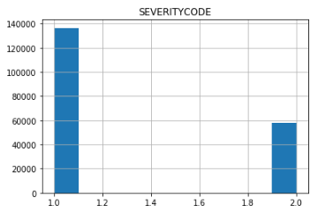
Data to Predict
Severity Code
Severity Code | Description | Amount of data
1 | Prop damage | 136,485
2 | Injury | 58,188

Slide 11
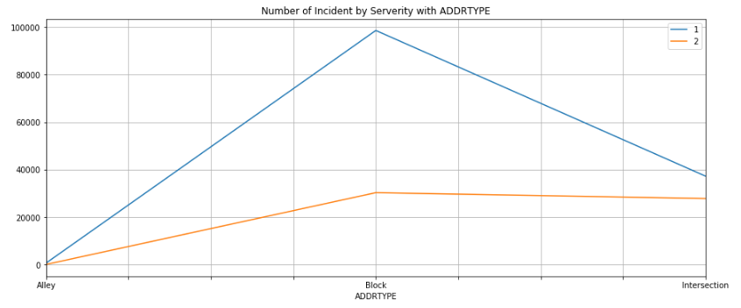
ADDRTYPE group by severity code

Slide 12
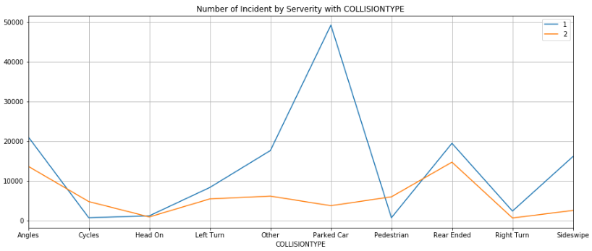
COLLISIONTYPE group by severity code

Slide 13
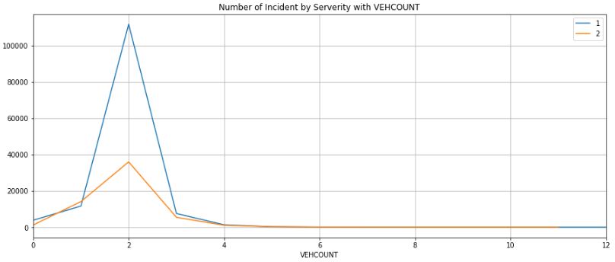
VEHCOUNT group by severity code

Slide 14
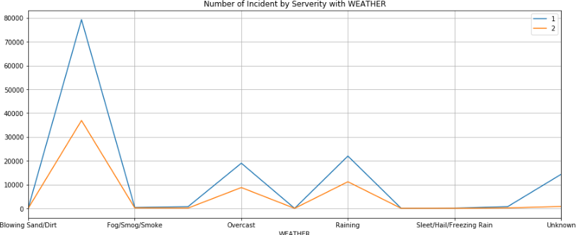
WEATHER group by severity code

Slide 15
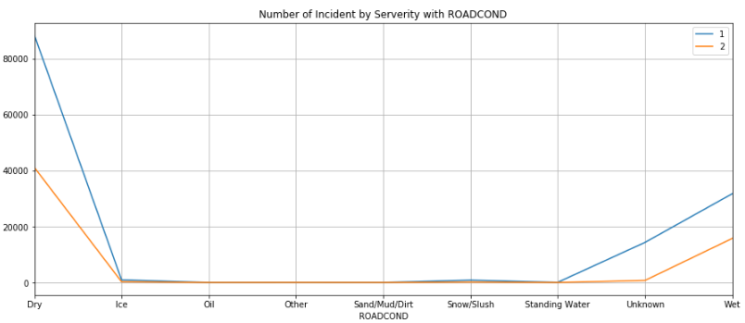
ROADCOND group by severity code

Slide 16
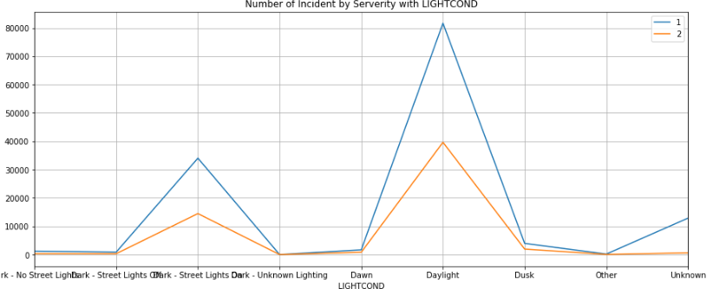
LIGHTCOND group by severity code

Slide 17
Data Analysis

Slide 18
Pearson Correlation
Data | Pearson Correlation with SEVERITYCODE
SEVERITYCODE | 1
PERSONCOUNT | 0.130949
PEDCOUNT | 0.246338
PEDCYLCOUNT | 0.214218
VEHCOUNT | -0.054686
SDOT_COLCODE | 0.188905
UNDERINFL | 0.044377
ST_COLCODE | -0.165233
HITPARKEDCAR | -0.101498
There is no linear correlation to SEVERITYCODE.

Slide 19
Decision Tree
Max depth = 5
Accuracy (the fraction of correctly classified samples) = 0.7537584329303791

Slide 20
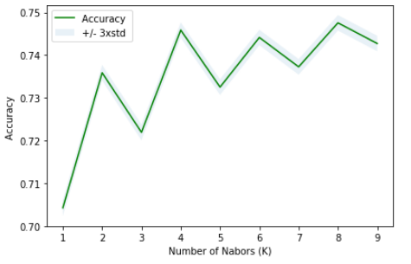
K-Nearest Neighbor (KNN)
From experiments, K is 1 to 10, the best K is 8.
Accuracy (the fraction of correctly classified samples) = 0.7475771377692545

Slide 21
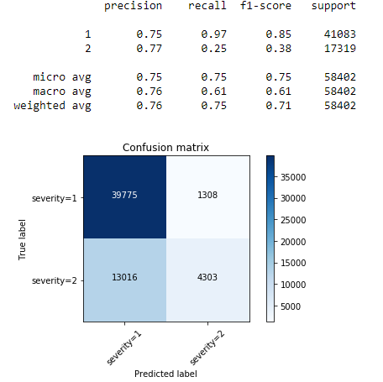
Logistic Regression
Use Solver Liblinear
Accuracy
Jaccard similarity score = 0.7547344269031883
Confusion matrix (F1 average) = 0.7173683103496501

Slide 22
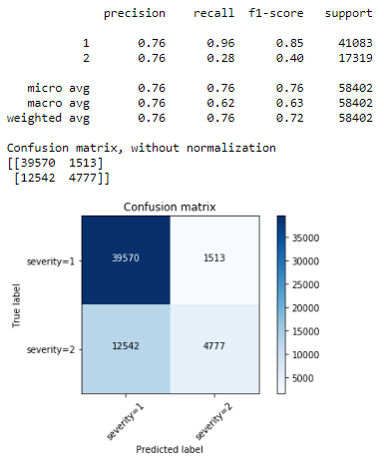
Support Vector Machine (SVM)
Kernel ‘rbf’
Accuracy
The fraction of correctly classified samples = 0.7593404335467964
Confusion matrix (F1 average) = 0.7173683103496501

Slide 23
Summary
Decision tree algorithm, K-Nearest Neighbor algorithm (KNN), Logistic Regression, and Support Vector Machine algorithm (SVM), shows similar ability to predict the severity level.
Decision tree and SVM has accuracy score 76%, where KNN and Logistic Regression have accuracy score 75%.

